Slide 1










SasView
Update and Roadmap Discussion
2019-03-29

Slide 2





A little history …
2006
Heritage: NIST IGOR macros
SansView is DANSE project output
~ 8.5% of funds were for SANS
2011
2012
NIST Supported initial transition from NSF funding
2013
Transition to Community project.
1st Code Camp at NIST April 2013
2014
2nd Code Camp at ISIS April 2014
2015
Move to GitHub
v3.0 released
3rd Code Camp at ESS Feb 2015
Rename to SasView
v3.1 released
2016
4th Code Camp at TU Delft March 2016
v4.0 released
5th Code Camp at ORNL Oct 2016
2017
v4.1 released
6th Code Camp at ILL/ESRF April 2017
7th Code Camp at DMSC October 2017
2018
v4.2 released
8th Code Camp at ESS Sept 2018
v5.0b1 released
1st SasView User Meeting at SAS2018
2019
v4.2.1 released
9th Code Camp at ILL/ESRF March 2019
v5.0b2 released

Slide 3
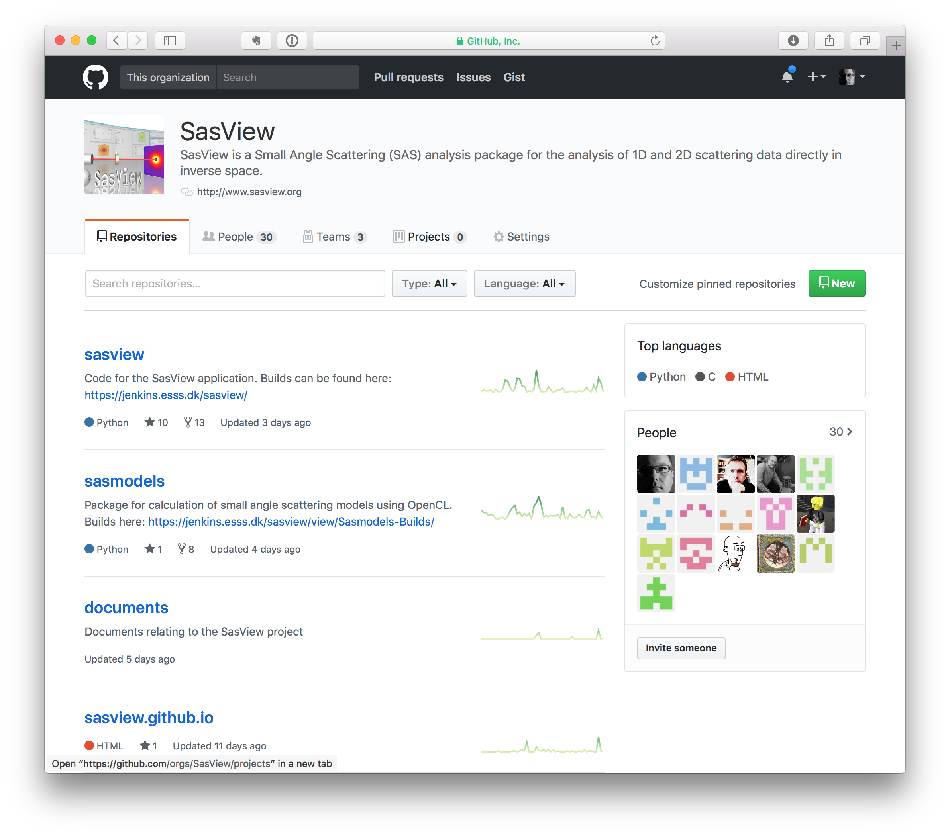
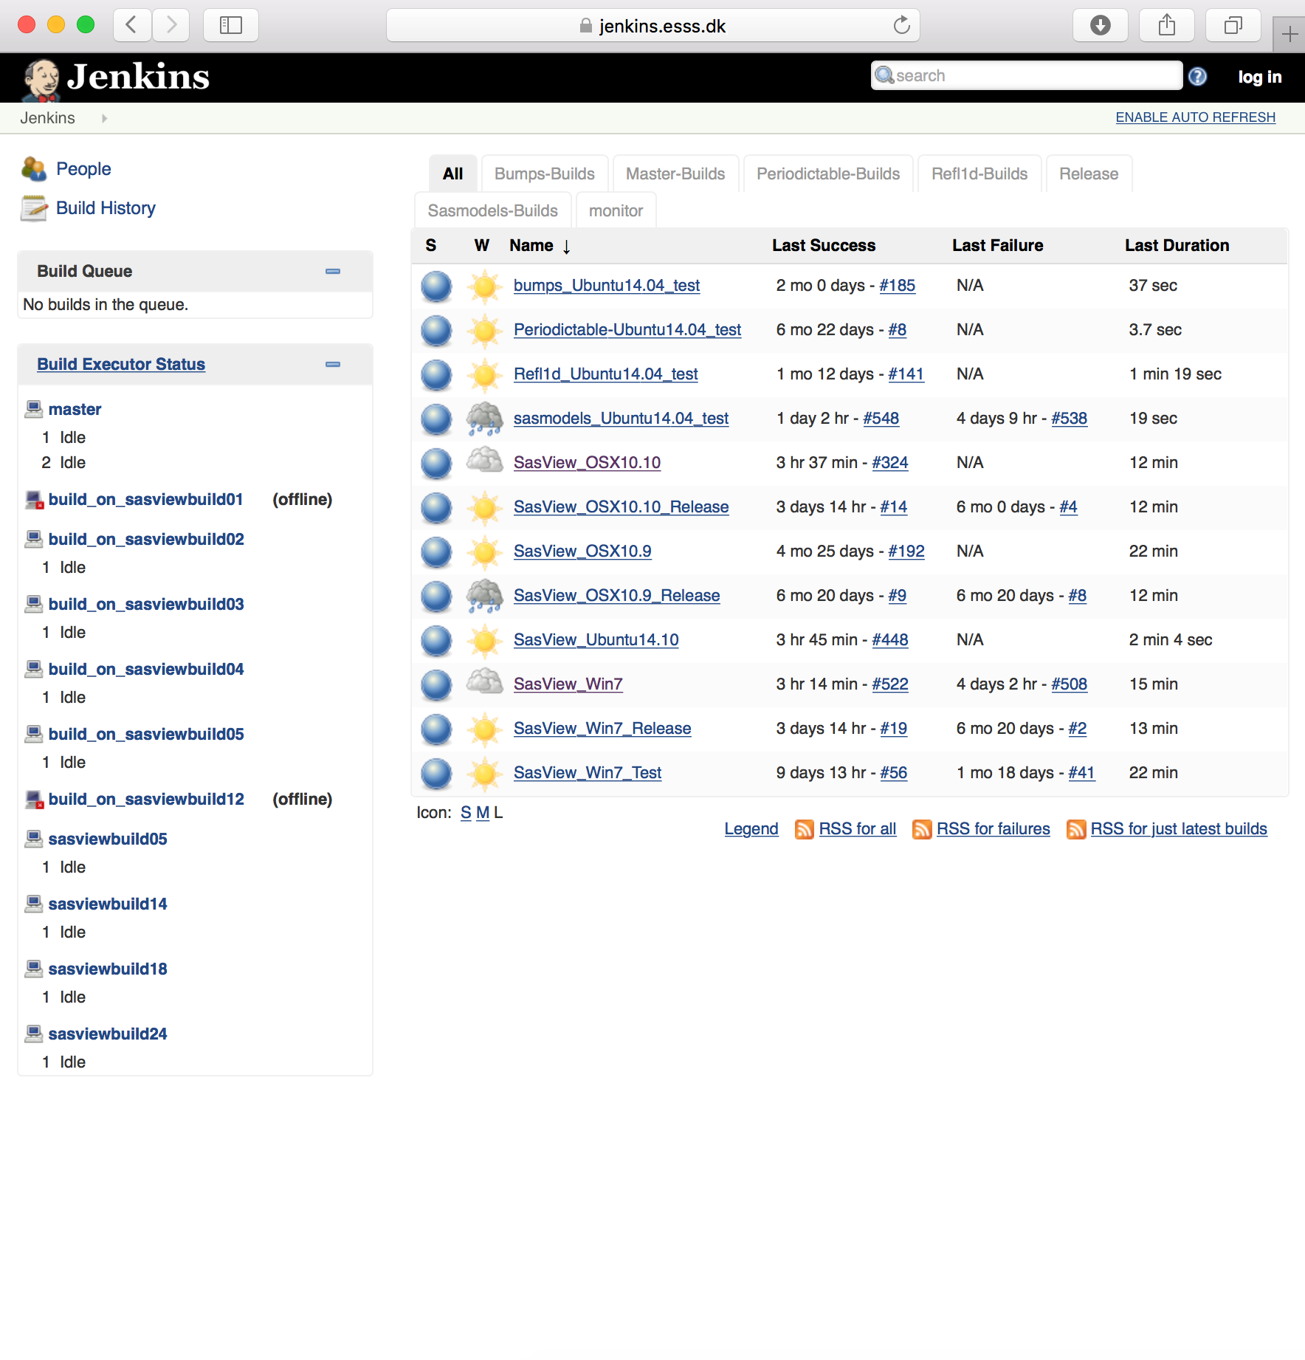
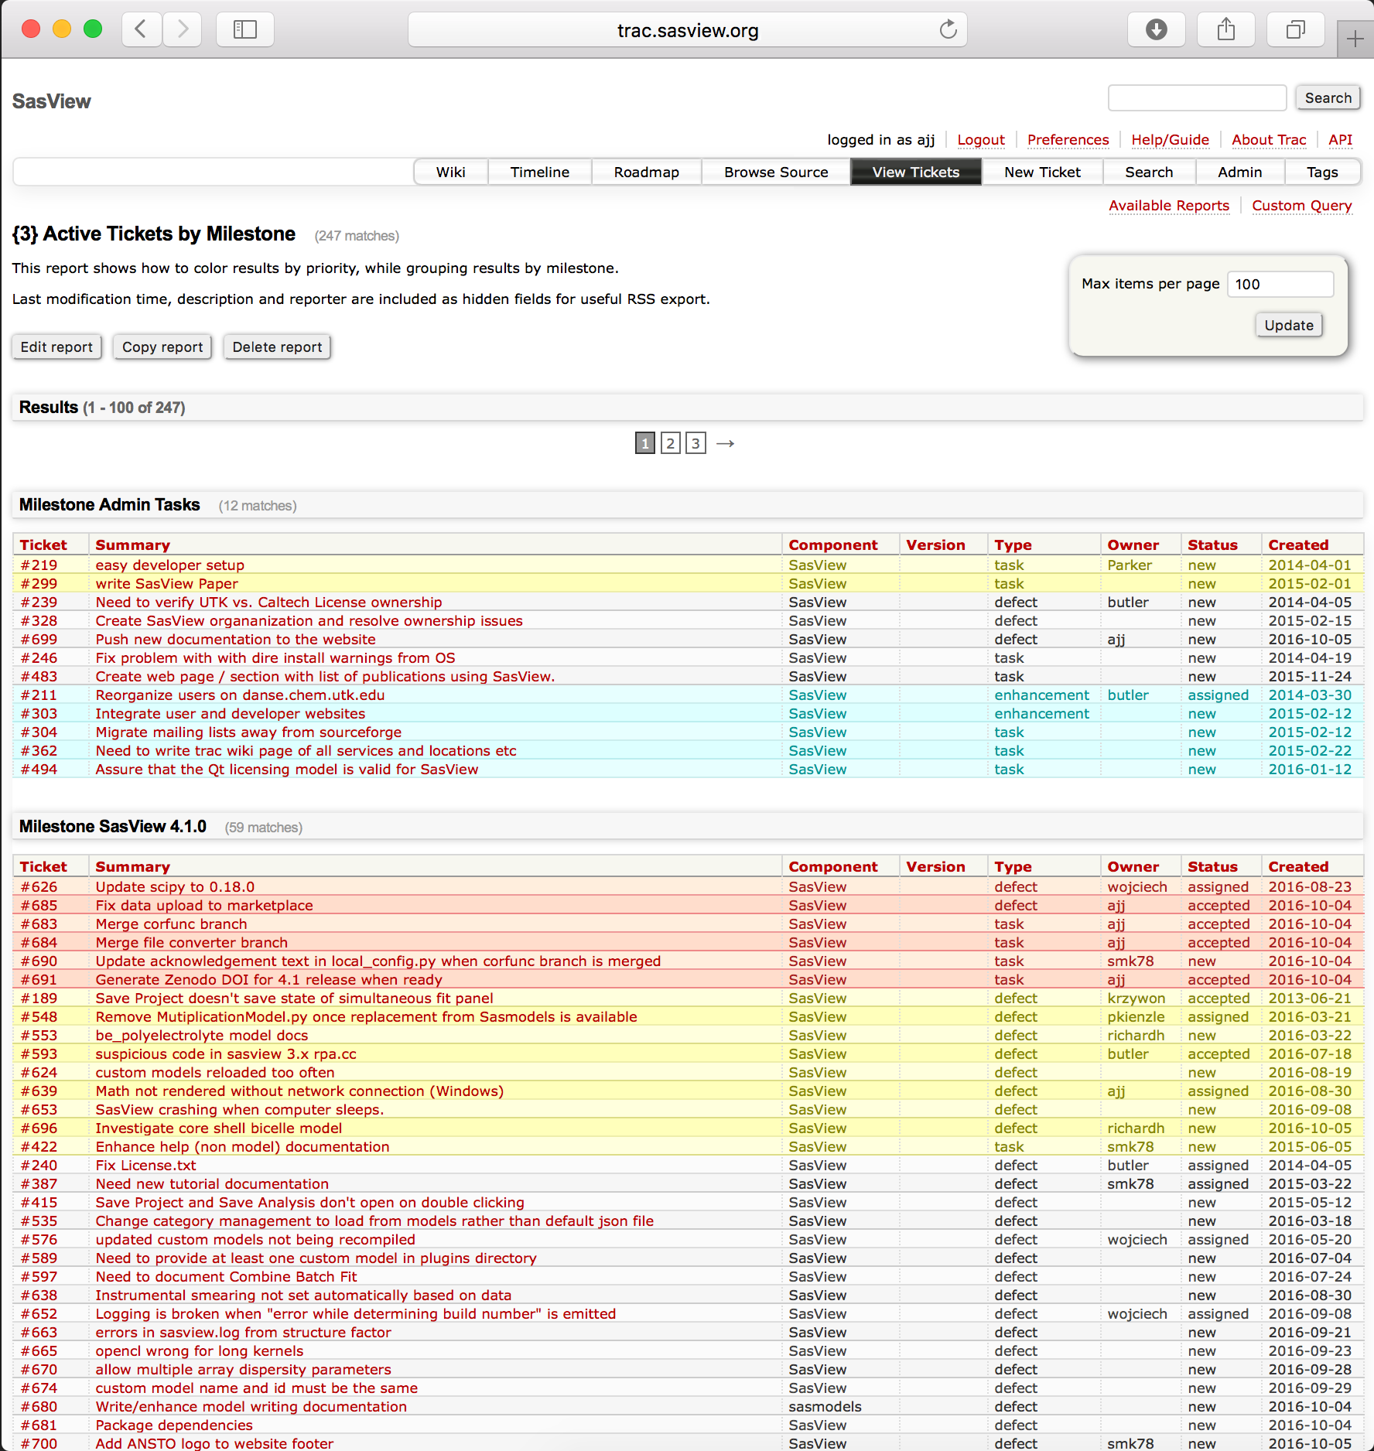
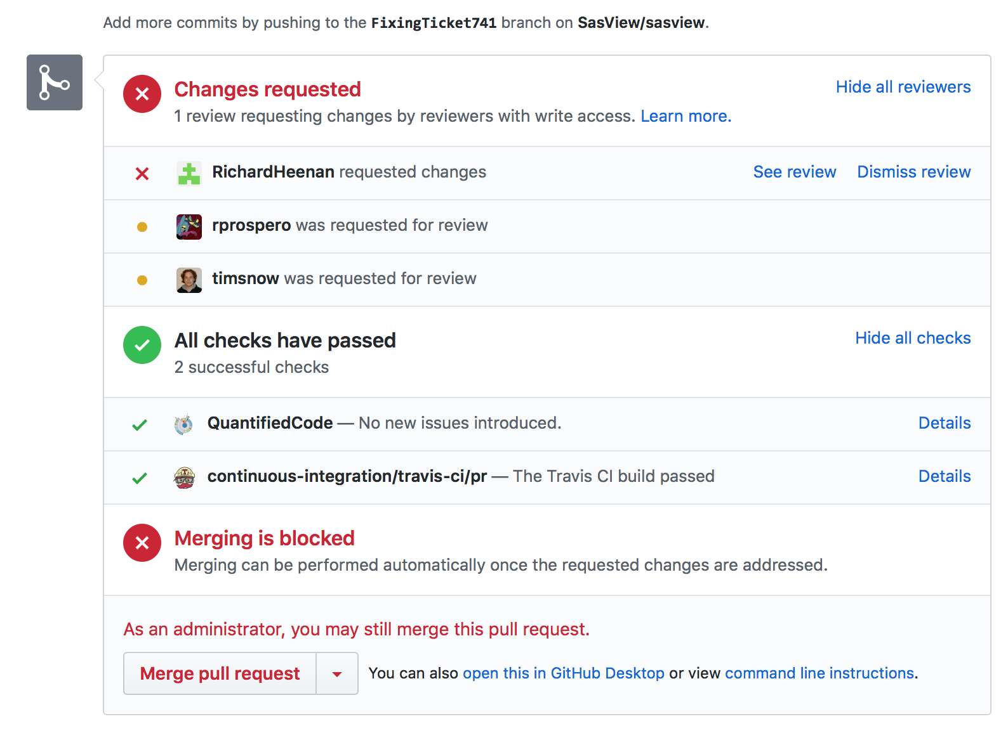
How We Work
Open, Collaborative, Community Development
Code is open source and publicly hosted at Github
Released under BSD 3-clause license
Bug and Enhancement Ticket System (Trac)
Bi-weekly developer calls
Code Camps
5 Year Roadmap
Model Marketplace
Task and bug tracking. Developer wiki
trac.sasview.org
Code Hosting and some CI/testing of PRs
Automated Builds
build.sasview.org
http://www.sasview.org
http://github.com/SasView

Slide 4
How We Work
http://www.sasview.org
http://github.com/SasView
Open, Collaborative, Community Development
Collaborative:
(S)he who brings the resources (time and effort or funds to buy time and effort) chooses what to work on
You are not allowed to break what is already there for others.
Community Development:
Ask not what the community is going to do for you,
ask what you can do for the community

Slide 5
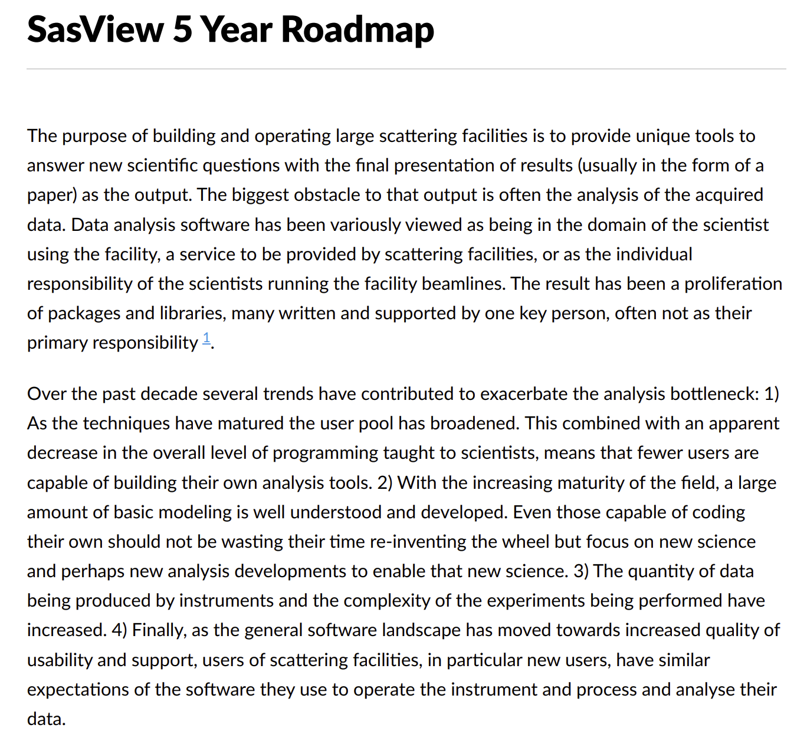
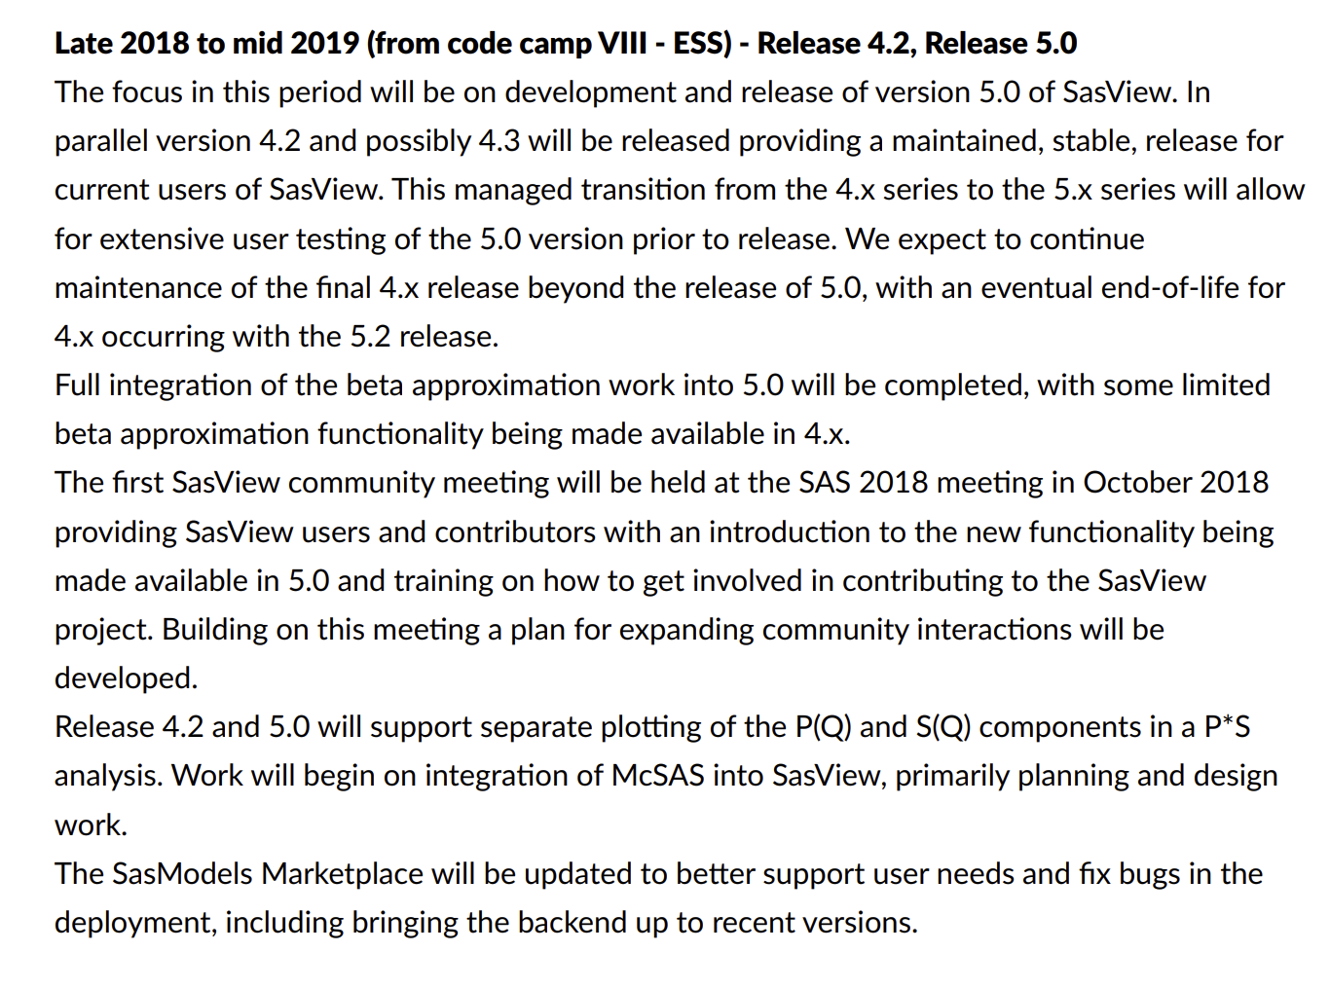
The RoadMap
Living document
Directs work for developers and helps find candidate projects for funding.
Discussed and updated at each Code Camp - NOW!
https://github.com/SasView/documents

Slide 6
Roadmap Late 2018 to mid 2019
Move focus of all GUI efforts to the new Qt GUI Done. Major bug fixes only to 4.x GUI
Parallel development and release tracks (5.x + 4.x) Working, but needs streamlining from 5.0 release
Complete beta approximation work In testing
New, more flexible interaction volumes/radii Underway?
Community meeting at SAS 2018 Done
Complete SasView paper Started
Consolidate and extend training material - both written tutorials and hands-on training material. Ongoing
Update model marketplace Needs developer
Create plan for developing community interactions. Started
Fixes to custom model editor to support polydispersity Done
Incorporation of models from:
SASFit^7 Work done, but not shipping by default. https://github.com/SasView/sasfit-models
Scatter^8 (Förster - crystalline materials models primarily) In discussions with BornAgain team
Project infrastructure cleanup:
ticket review/cull given 5.0 release Ongoing
possible move to GitHub issues. Underway
Release
5.0 alpha (late 2018) Done
5.0 beta (early 2019) Done
5.0 (mid 2019) On track
4.2 Done
Not in roadmap for this period …
Complete separation of sascalc package / headless usage
https://github.com/SasView/documents

Slide 7
Current Status of Future Roadmap Activities
Status of 5.0 and transition from SINE2020 to community - Wojciech
Developing community interactions
Welcoming new contributors - Butler for Jackson
New website and cleanup of twitter feed - Butler for Jackson
e-learning - King
Future code camps vs boot camps - Wojciech
SasView paper, DOIs and publication tracking - Butler for Jackson
Paper on Overleaf with assignments
DOI for EVERY release for traceability in emerging publication standards
https://zenodo.org/communities/sasview-analysis/?page=1&size=20
Publication tracking - Sneak peak at www.sasview.org/publications
Headless operation - Wojciech
Infrastructure work - moving fully to github - Ricardo

Slide 8
Roadmap Late 2019 to mid 2020
Begin model fitting refactoring work to allow custom re-parameterization of models, allow reading in an array representing either PQ or SQ for P*S fits, fitting oriented model to 1D cuts including revisiting orientation definitions etc. Discussed at this code camp
Complete architecture manual
Begin work on refactoring constrained/simultaneous fits.
Begin work on adding custom workflows identified as highest priority
Work to update tutorials to support 5.x
Begin work on advanced model fitting tutorial
Usual bug fixes and other minor improvements as time and interest permit
Integration of McSAS
Begin work on generic O-Z solver
Inclusion of PRISM^9 functionality
Begin work to refactor/improve generic scattering calculator
Improvements to custom model editors including features from compare.py
Support for multi-GPU, multi-CPU and CPU/GPU computation
https://github.com/SasView/documents

Slide 9
Roadmap mid 2020 to mid 2024
Refactor Simultaneous/Constrained fitting - significant changes in 5.0
New Workflows
Web UI (and Phone App)
Headless - essentially done in 5.1?
Intelligent limits/help ⇒ “AI” ?
Add support for ASAXS
Enable transparently running computational code remotely from within local GUI - dependent on headless
https://github.com/SasView/documents

Slide 10
Discussions this week
Reparameterisation of models
Including more complex structure factors
Include material from Scatter
1D oriented data … How to fit a slice from a 2D dataset
Project to do benchmarking of optimisers
Computation speed and integration options and approaches
Aiming to move to 9-monthly cadence for code camps
Camp X - Jan/Feb 2020 (likely in US)
Camp XI - Oct/Nov 2020 (likely in Europe)

Slide 11
Discussion ...
What do you want to see in SasView?
How can you help?

